Slide 1
CM1605 Web Technology
HCI UX/UI Principles, Usability, Accessibility, Structure and Navigation
Week 8| Janani Harischandra

Slide 2
Learning Outcomes
Covers LO3 for Module
On completion of this lecture, students are expected to be able to:
Understand UI/UX –HCI principles relate to web design.
Demonstrate a good level of knowledge on web usability and design guidelines, web accessibility standards and web structure and navigation.
Apply Web UI/UX methods for website in a given context.

Slide 3
Content
Usability
Understand User
Web UX/UI principles
Colors
Typography
Good design
Accessibility
Web Structure and Navigation

Slide 4
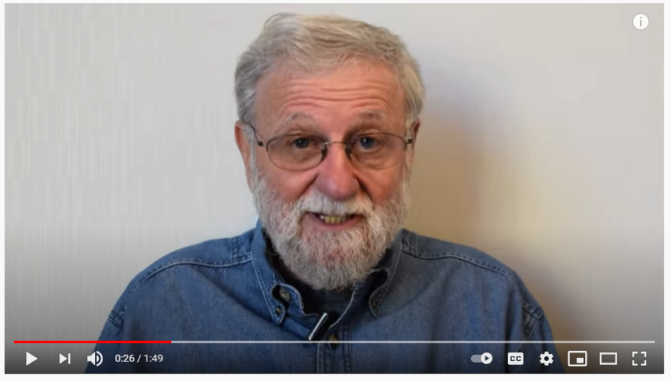
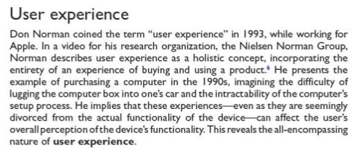
User Experience

Slide 5

Usability

Slide 6

Achieving Good Web design
Understand User
Understand the goal of the website
Coveys functionality, make it accessible

Slide 7
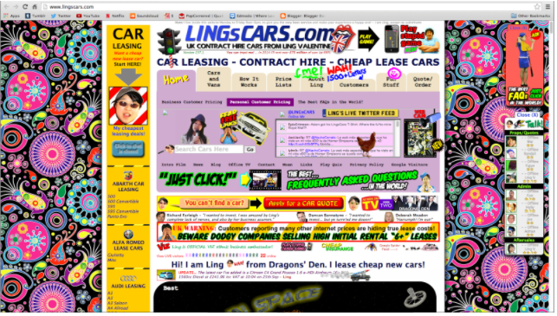

What is wrong with this? - Discuss
Is the site beautiful?
Visually Appealing?
Structure?
Legibility?
Colors?
Typography?

Slide 8
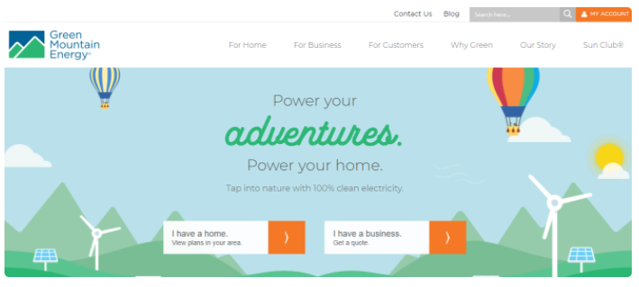
First Impression

Slide 9
Usability
Usability is a quality attribute that assesses how easy user interfaces are to use
Measure of the effectiveness of a tool.
The more usable the tool, the better we achieve our goals.
Tools can be frustrating
Poorly designed
Functional limitations

Slide 10
Usability on web
If a website is difficult to use people leave
If the homepage fails to clearly state what a company offers and what users can do on the site, people leave.
If users get lost on a website, they leave.
If a website's information is hard to read or doesn't answer users' key questions, they leave
The first law of ecommerce is that if users cannot find the product, they cannot buy it either.

Slide 11
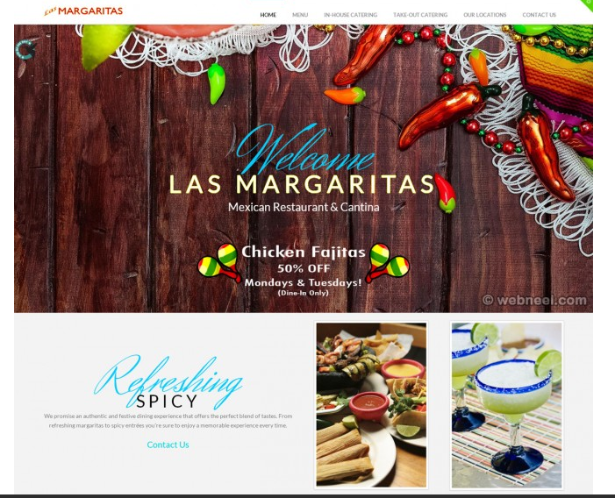
Good Design = beautiful + functional

Slide 12
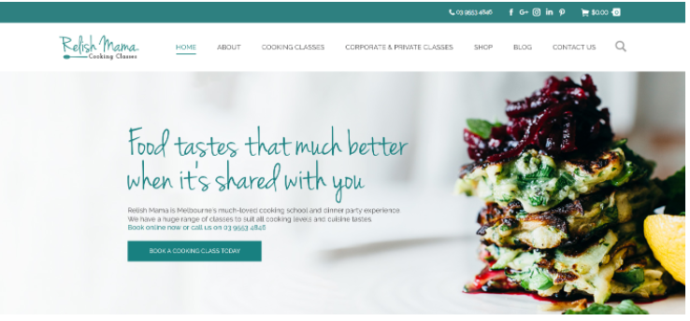
Good Design = beautiful + functional

Slide 13
Understand User

Slide 14
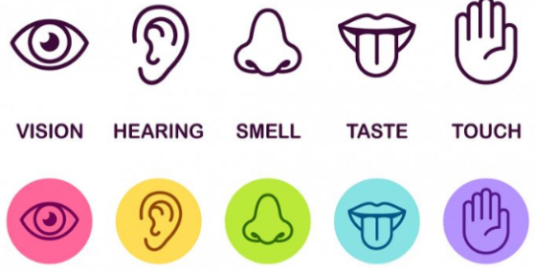
Understand the user
Humans are limited in their capacity to process information.
This has important implications for DESIGN.
Information is received and responses given via a number of input and output channels:
Input
Output
Limbs
Vocal System
Head
Fingers

Slide 15

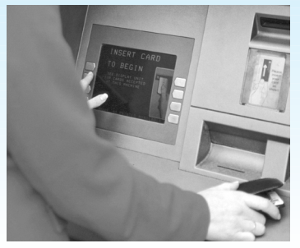
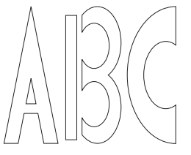

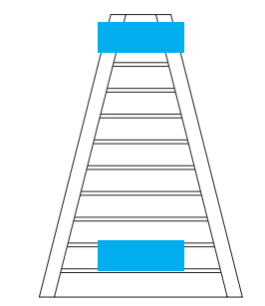
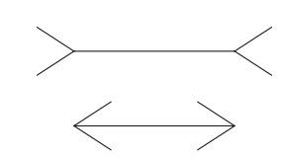
Capabilities and Limitation of users
Vision
Reading
Memory
Adults read approximately 250 words a minute
Reading speed is affected mainly by the size of the font and the distance between lines
Design guidelines
Response times must be fast
Clearly mark visited links
Make it easy to scan for and compare information
Progress bars
Which is longer?
Are these lines the same size?

Slide 16
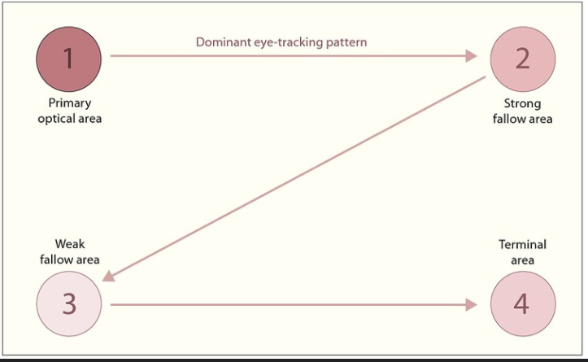
Understand User

Slide 17
Individual differences
Age
children
elderly
Disability
Education
Personality
Motivation
Culture
Cognitive skills
Motor control
Reaction time
Memory
Language
Knowledge representation
Visual stimulus

Slide 18
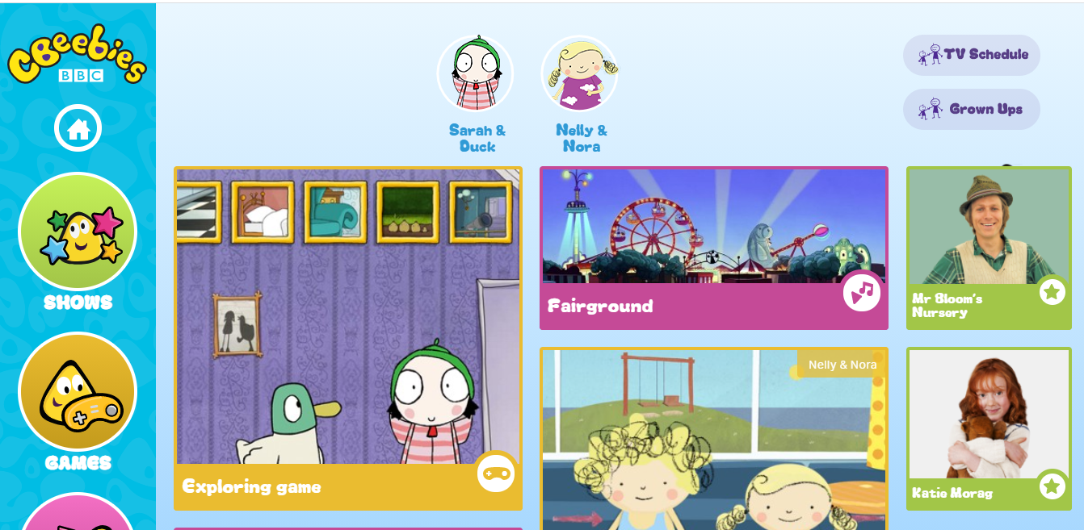
What do you think about Target Audience?
https://global.cbeebies.com/

Slide 19
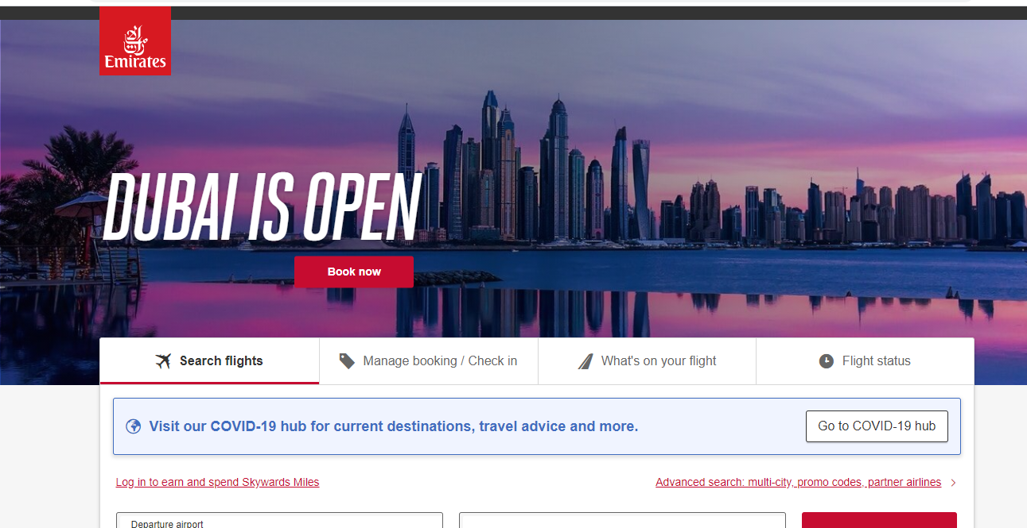
What do you think about Target Audience?
https://www.emirates.com/lk/english/

Slide 20
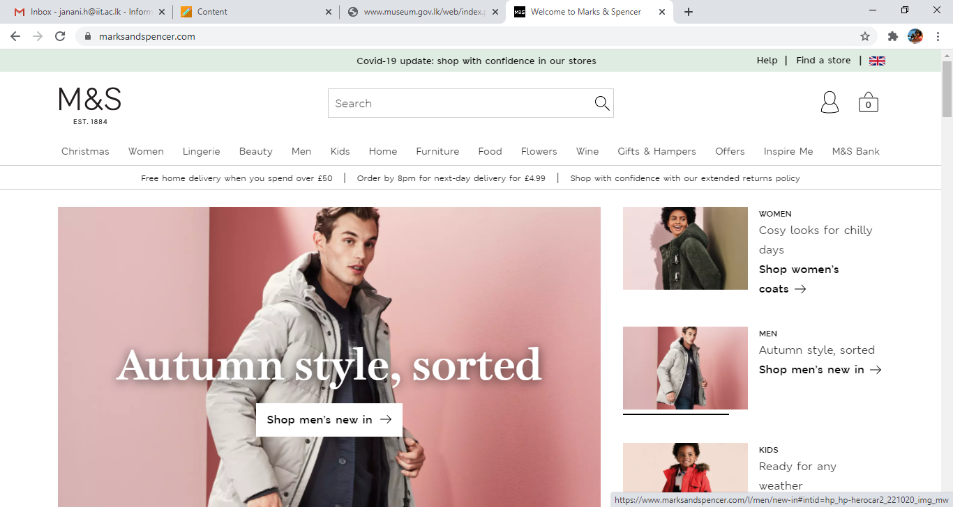
What do you think about Target Audience?
https://www.marksandspencer.com/

Slide 21
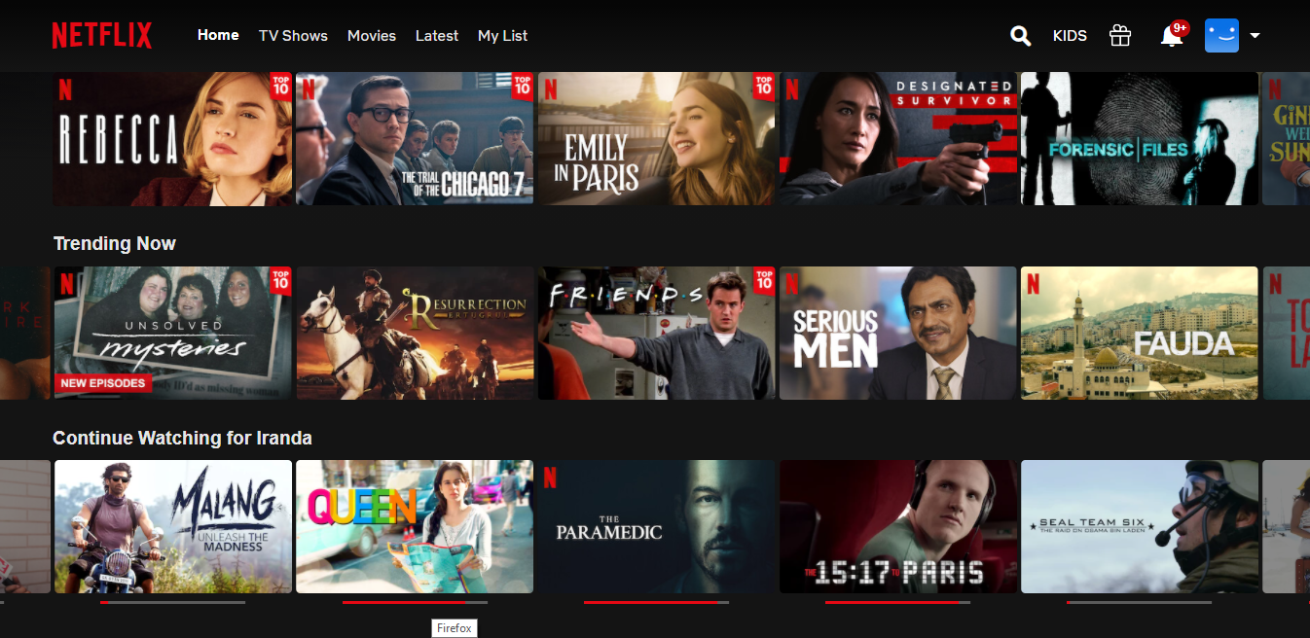
What do you think about Target Audience?
https://www.netflix.com/browse

Slide 22
Achieving Good Design
Color
Typography
Iconography
Shapes
Images/Graphics
Brand Tone

Slide 23

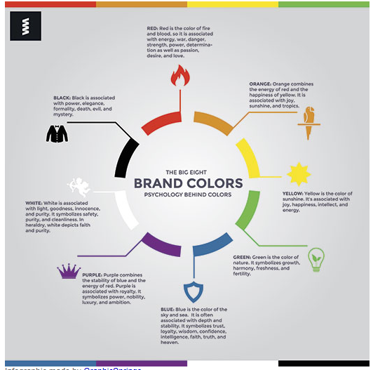
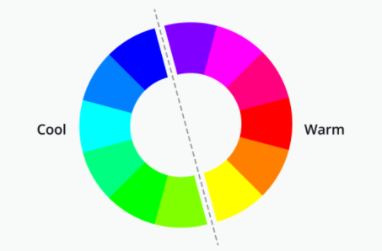
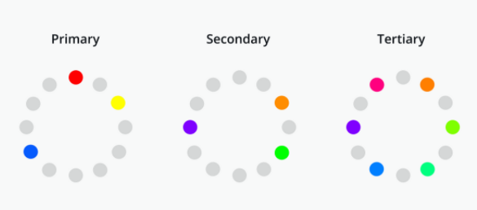
Colors Associations for Web Design

Slide 24
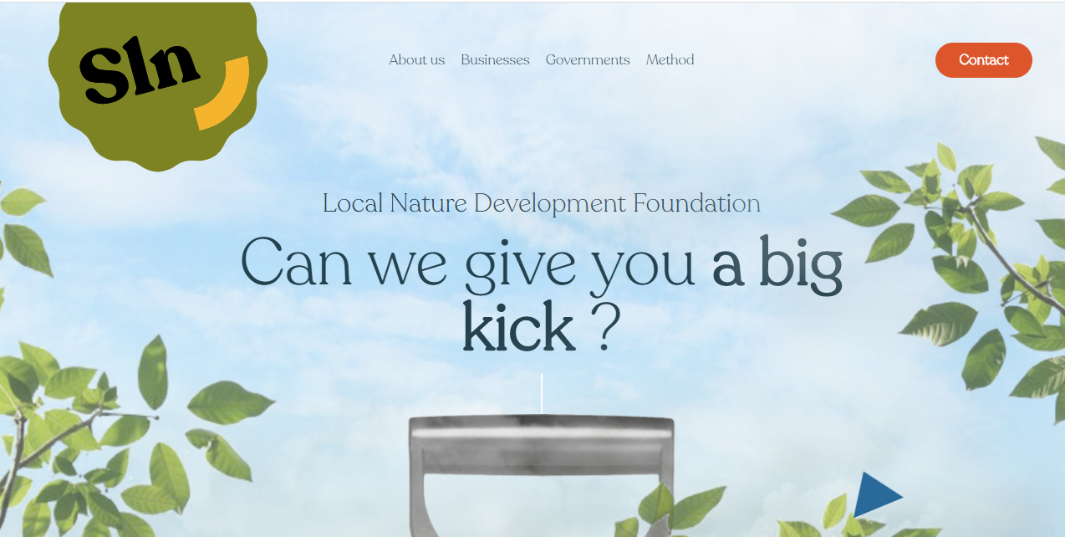
Cool Colors

Slide 25
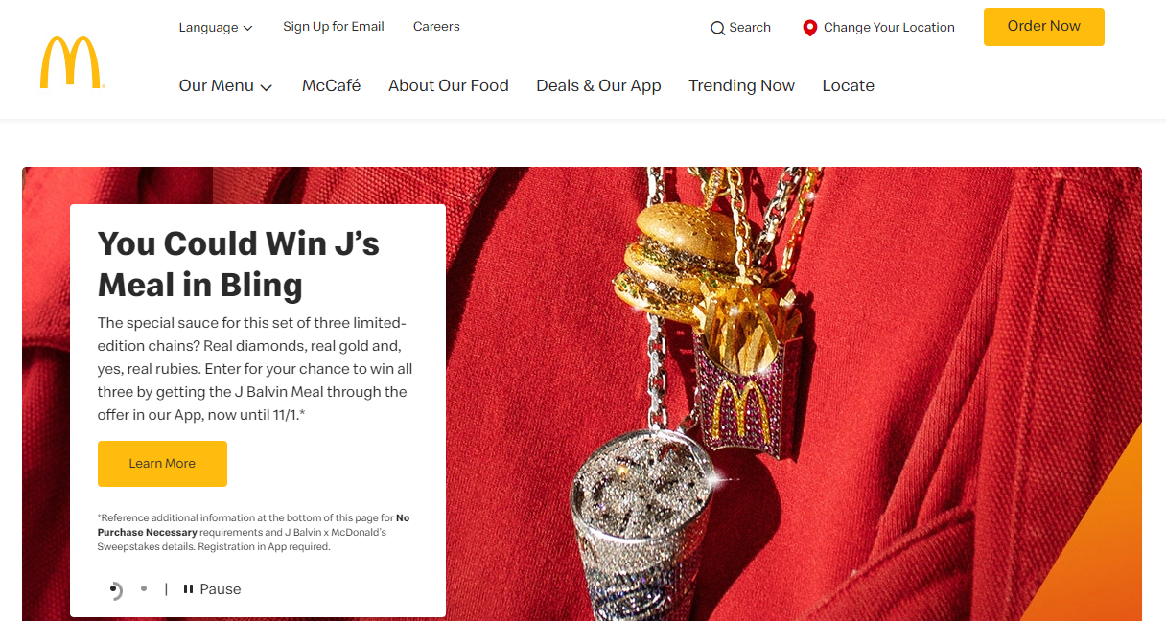
Warm Colors

Slide 26

Anything Wrong?

Slide 27
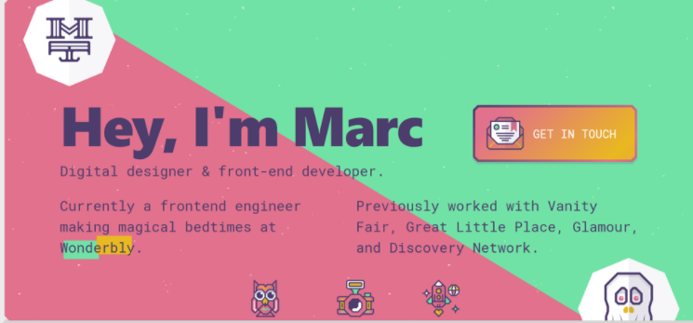
What about this?

Slide 28
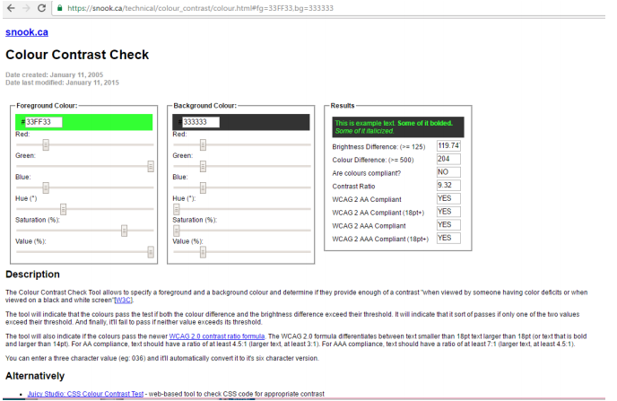

Check Color Contrast

Slide 29

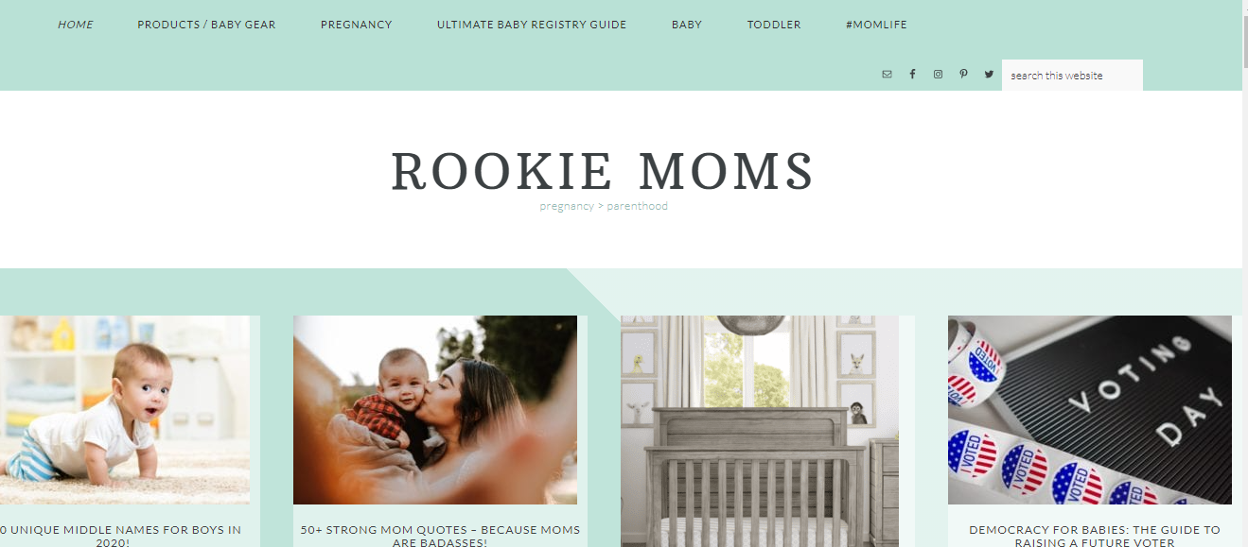
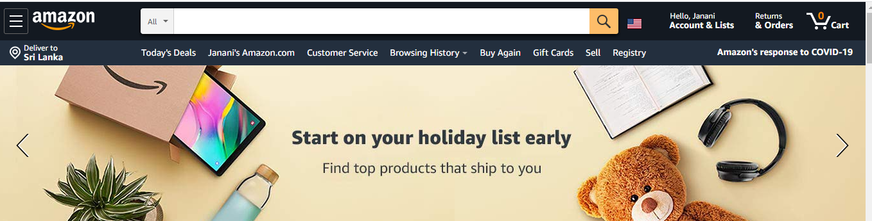
Consistency of Web Sites
CSS
Sharing same colour combination throughout the website
Text links the same colour throughout the website
Form elements shares the same style
Headings consistent throughout the site
Navigation bar in the same place throughout the website
Icons of the same family
Same interaction style used

Slide 30
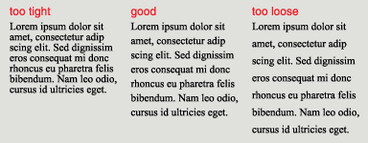
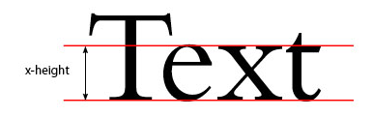
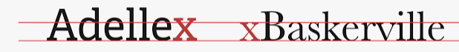
Typography
Line Spacing | Font size | X-height
Optimal line length on the Web is considered between 50-60 characters Keep the ratio between 1.2 to 1.5 | Most browsers suggest 16 pixel as default font size. Recommended distance between eyes and monitor is 28 inches. | large x-height – they are perceived as being larger overall, and thus are more readable.

Slide 31
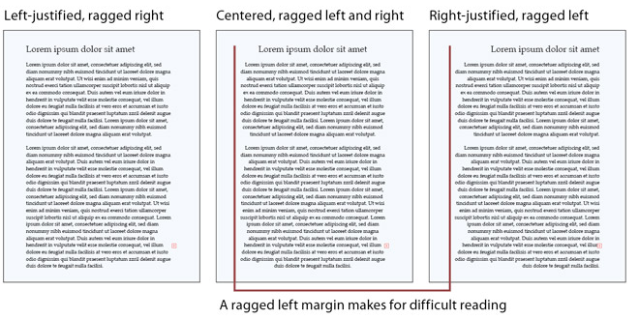
Typography

Slide 32
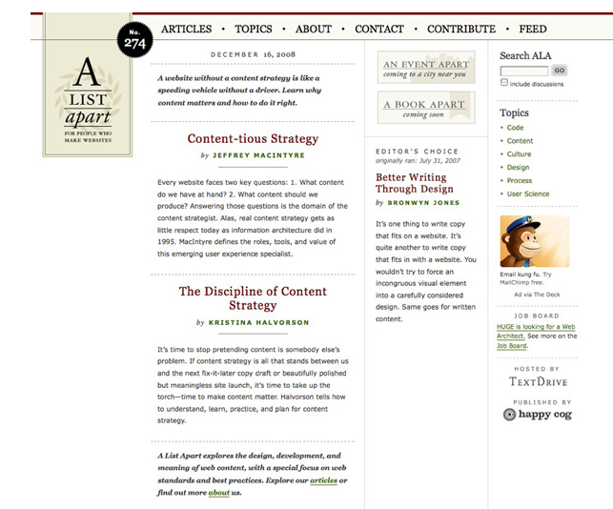
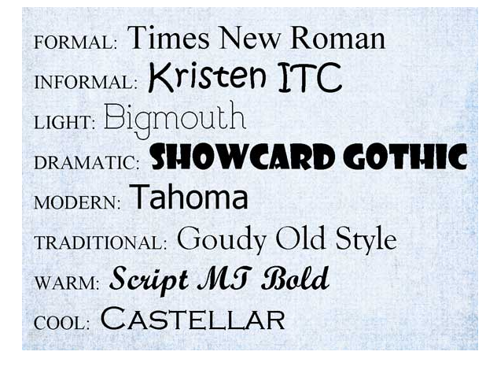

Typography - facts
Show preference for san serif
Typography Moods

Slide 33
Accessibility

Slide 34
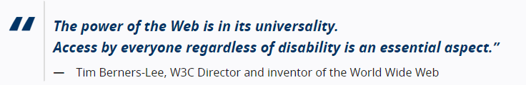

Accessibility :Web
Web accessibility means that websites, tools, and technologies are designed and developed so that people with disabilities can use them. More specifically, people can:
perceive, understand, navigate, and interact with the Web
contribute to the Web

Slide 35
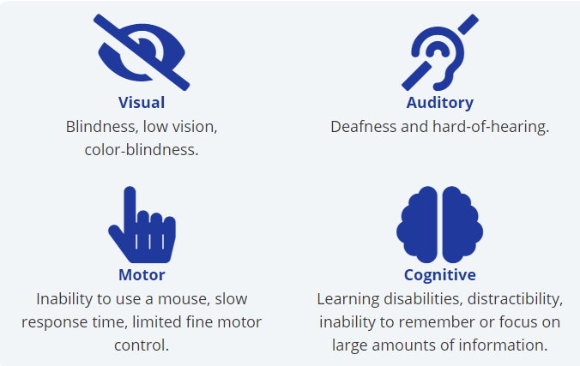
People with Disabilities on the Web
The internet is one of the best things that has ever happened to people with disabilities.
Screen reader software - Designed to read online content aloud for Blind people.
Screen Magnifiers – Present enlarged screen content.
Eye gaze systems
Touch screens
Alternative input devices- joystick, trackballs
Notes:
Web accessibility also benefits people without disabilities, for example:
people using mobile phones, smart watches, smart TVs, and other devices with small screens, different input modes, etc.
older people with changing abilities due to ageing
people with “temporary disabilities” such as a broken arm or lost glasses
people with “situational limitations” such as in bright sunlight or in an environment where they cannot listen to audio
people using a slow Internet connection, or who have limited or expensive bandwidth

Slide 36
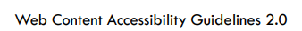
HTML Accessibility Techniques
Text Accessibility Techniques
Image Accessibility Techniques
Table Accessibility Techniques
Form Accessibility Techniques

Slide 37
Text Accessibility Techniques
<html lang=“en”>
Specify the languages used for screen readers
<title> Home | RGU </title>
Screen readers uniquely identify pages
<h1>Heading</h1>… <h2>Heading</h2>
Use of proper headings help structure document, read by Screen readers
<meta name=“author” content=“Janani H”>
Why specifying keywords?
Use <p>, <em>, <blockquote>, <ul>…
Read by screen readers, improve consistency

Slide 38

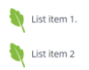


Image Accessibility Techniques
<img src=“flower.jpg” alt=“sunflower”/>
Informative images - Alt= A short description conveying the essential information presented by the image.
<img src=“flower.jpg” alt=“”/>
Decorative images – Alt=“” purpose of an image is to add visual decoration to the page
<img src=print.png alt=“print this page”/>
Functional Images–Alt=“describe the functionality of the link or button ”
<img src=“sig.jpg” alt=Your access to the city”/>
Images of Text – Alt =“images of text are used, the text alternative should contain the same words as in the image.”

Slide 39

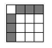

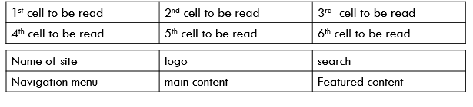
Table Accessibility Techniques
Tables with one header for rows or columns
Mark up header cells with <th> and data cells with <td> elements
Tables with two headers have a simple row header and a simple column header:
Define the direction of each header by setting the scope attribute to col or row.
A caption identifies the overall topic of a table and is useful in most situations. A summary provides orientation or navigation hints in complex tables.
Table linearization :Avoid tables for layout - > Use CSS
Caption & Summary
<table summary =“……………………”> <caption>Caption description</caption></table>
Violates separation of content and presentation
Causes problems for
Screen readers
Text browsers
Narrow-width browser windows

Slide 40
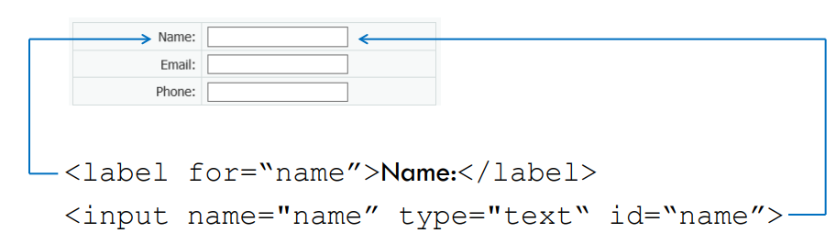
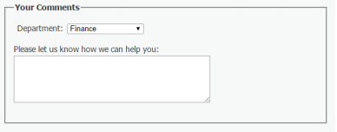
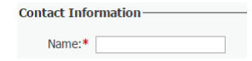
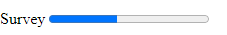
Form Accessibility Techniques
Use Explicit Labels – Supported with Screen readers
<label for = “name”>Label Text </label>
Grouping –filedset and legends
<fieldset> <legend>Contact information</legend>
<input type=“text” id =“fieldname”>
<label for = “email”>Email</label>
<input type=“email” id =“email”>
<fieldset>
Indicate required fields – Avoid using colors to for them
Use progress bar
<label for=“name” >Name*</label>
<input required aria-required=“true” type=“text”>
Survey <progress value="3" max="7">Step 3</progress>

Slide 41
Why HTML Accessibility Techniques important?
Screen readers
Read alternative text
Read row, column headers in tables
Speech input software
Linked image with a single voice command
Use the labels via voice commands to activate form controls
People with cognitive disabilities
Mobile web users
People browsing speech-enabled websites
The text alternative can be read aloud
Helps to understand and complete forms
Images can be turned off, especially for data-roaming

Slide 42
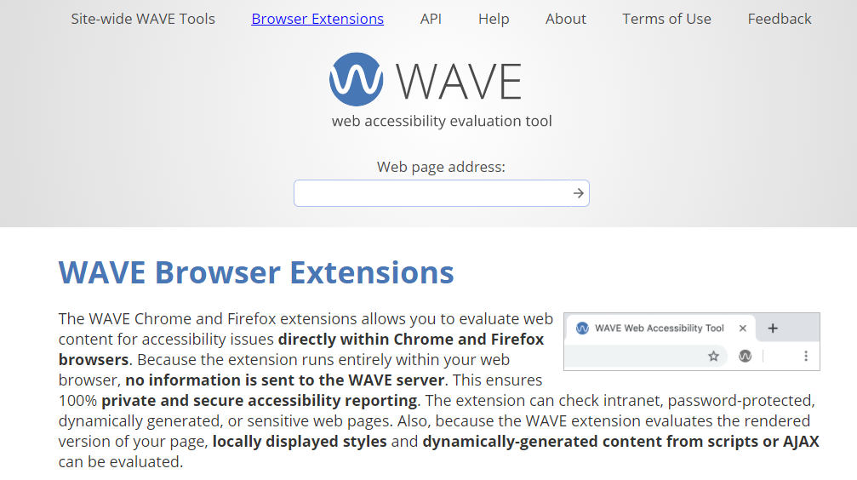
Check Accessibility

Slide 43
Navigation

Slide 44
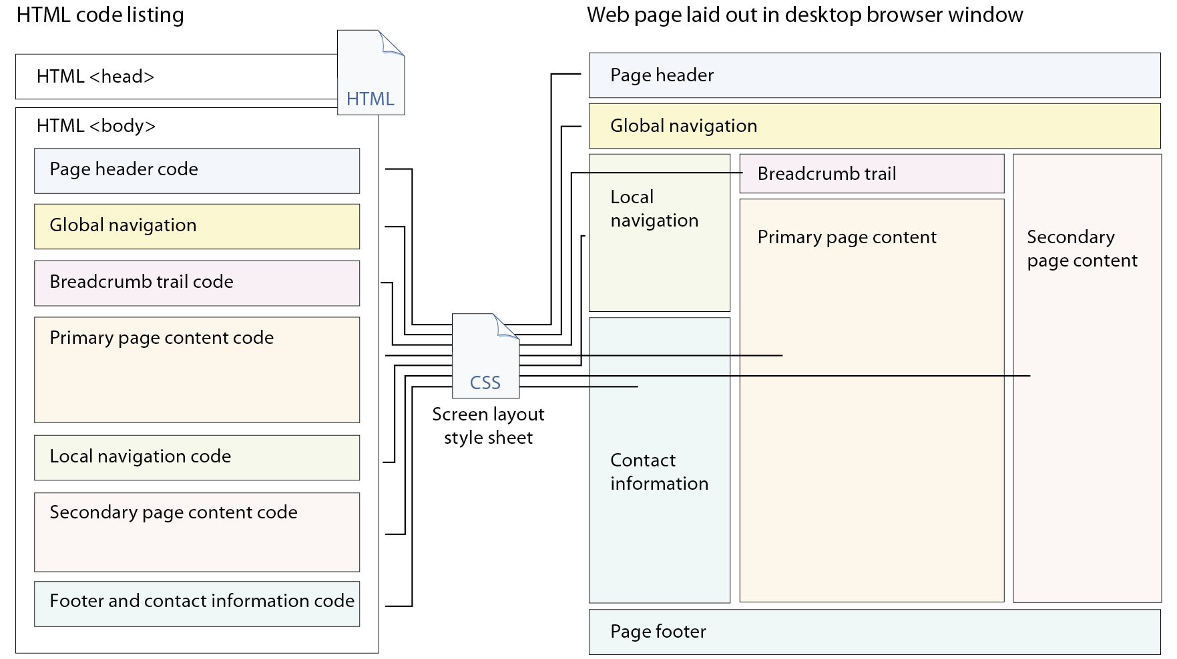
Page Structure Semantics
Header
Navigation
Main
Aside
Footer

Slide 45
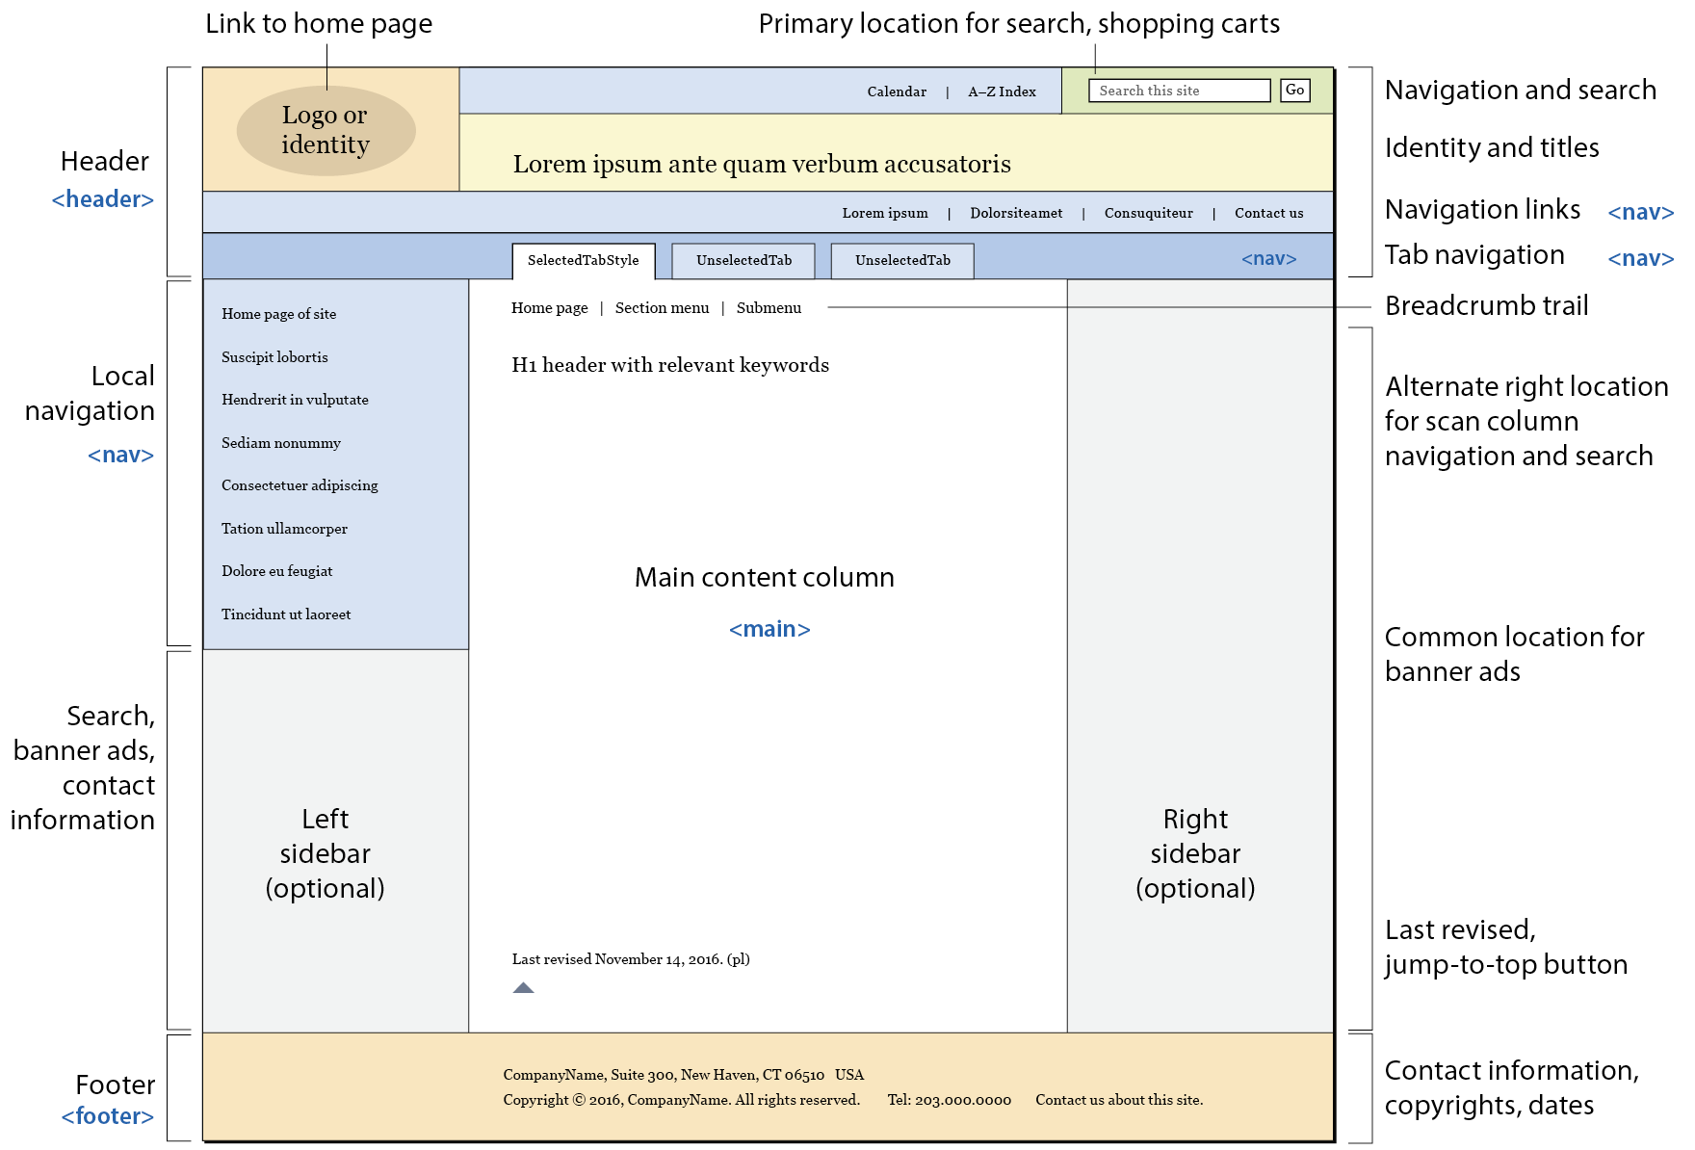
Page Structure

Slide 46
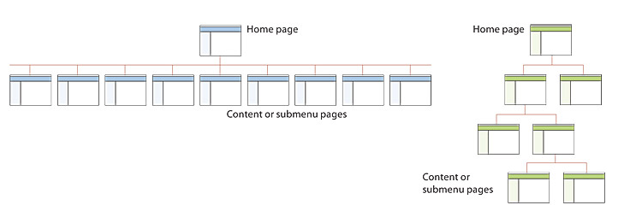
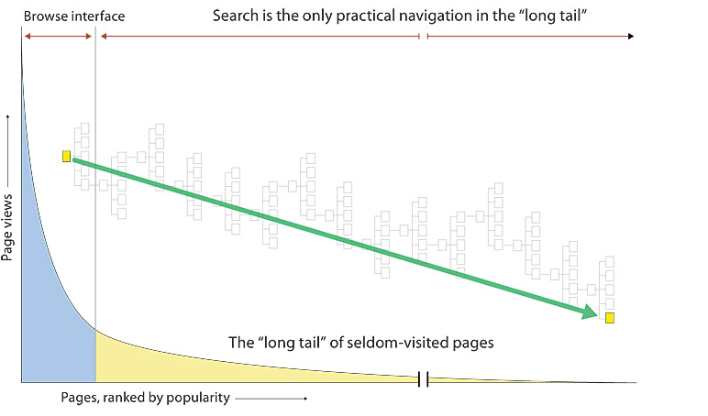
Site Structures – Shallow Vs Deep

Slide 47
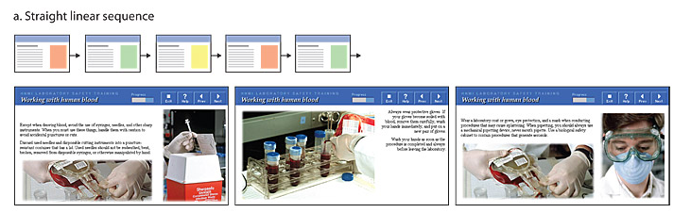
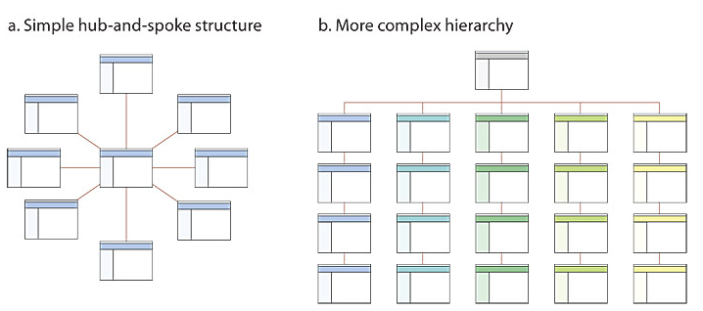
Site Structural Themes
Sequences
Simple
Hierarchies
Website organizations
Well organized
Chronological
Training sites; books,
Tree architecture
magazines

Slide 48
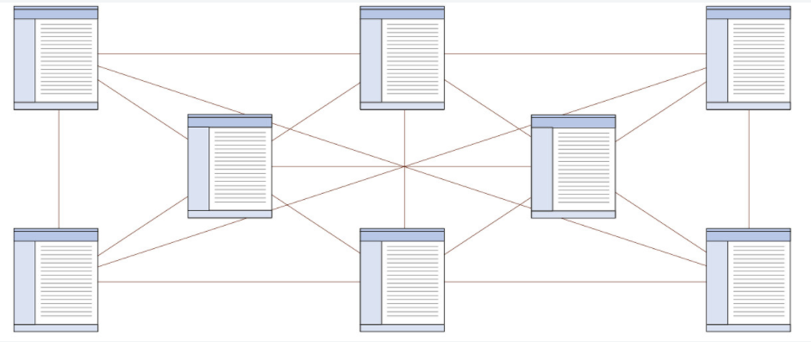
Site Structural Themes
Webs
Best for small sites
Mimic free flows of ideas
Suited for highly educated, experienced users.
Propagate confusion

Slide 49
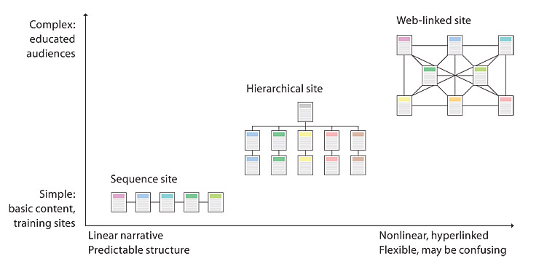
What is best?

Slide 50


Good Navigation
Notes:
Local (left column) and global (tabs below the header) navigation systems provide a flexible and easy to understand navigation system.

Slide 51


Good Navigation

Slide 52

Site Diagrams
Site diagrams visualize the developing information hierarchy and help communicate the organizational concepts to the team and to stakeholders and project sponsors.
Tools
Microsoft Visio
ConceptDraw
OmniGraffle

Slide 53

Site File and Directory Structures

Slide 54



Understanding User’s Expectations in a web page

Slide 55





Artificial Intelligence (AI) & User Experience
Any customer-centric web applications are starting to rely on AI in order to improve enhance the customer experience.
A website should be user-friendly, that the user on visiting it should find relevant products or content within seconds of entering the web.
AI –UX Principles addressed when designing AI products and services
UX adjectives and adverbs raise the bat for an experience of a product beyond “satisfying”

Slide 56
The Role of User Experience in Creating AI Applications
For the most part, it isn’t different, all of the core UX design tasks—understanding the people who would use the product, their objectives, and the ways the product can help them—remain the same.
The very fact that some folks think AI projects are significantly different from other UX design projects is actually one of the danger points.
People carried away by the technology and start thinking the AI capabilities alone are going to persuade people to use the product.
But they won’t—unless the product actually solves customers’ problems effectively.
it is essential to gain users’ trust when designing any application, but especially for an AI application.
Users will trust an organization enough to provide the data that drives many AI applications—especially the machine learning that supports personalization.

Slide 57
Using AI to improve User Experience
AI in UX
Chabot
Semantic Search
Personalized recommendations
Better Accessibility
These are essentially virtual assistants working as 24/7 customer support for website visitors.
Figure out the intent and contextual meaning of the search query, thus improving the accuracy of search results, and consequently boosting user satisfaction.
The ability to serve tailor-made content and personalized product recommendations (especially for SaaS and eCommerce stores)
AI provides language translation and captioning for people who are hard-of-hearing. It also enables automatic image recognition and alt text for visually-challenged people

Slide 58








AI in Web apps
AI in Web apps
Search Engines
Navigation
Chatbots
Social Network
Entertainment
Netflix
Youtube
Google Maps
Facebook
Instagram
Pinterest
Ecommerce
Ebay,Amazon

Slide 59
Reading
Chapter 3 and 5 of P.J. Lynch & S. Horton (2009) Web Style Guide: Basic Design Principles for Creating Web Sites. Yale University Press, 3rd edition.
Pickering, H. 2019. Inclusive Components: Accessible Web Interfaces, Piece by Piece. Smashing Magazine.
Watson, L. et al. 2015. Practical Approaches for Designing Accessible Websites. Smashing Magazine
Chapter 2 of P.J. Lynch & S. Horton (2009) Web Style Guide: Basic Design Principles for Creating Web Sites. Yale University Press, 3rd edition.
Web Style Guide Online
http://webstyleguide.com/wsg3/index.html
Introduction to Web Accessibility
https://www.w3.org/WAI/tutorials/
Introduction to Web Accessibility forms ◻ https://www.w3.org/WAI/tutorials/forms/

